Slide 1

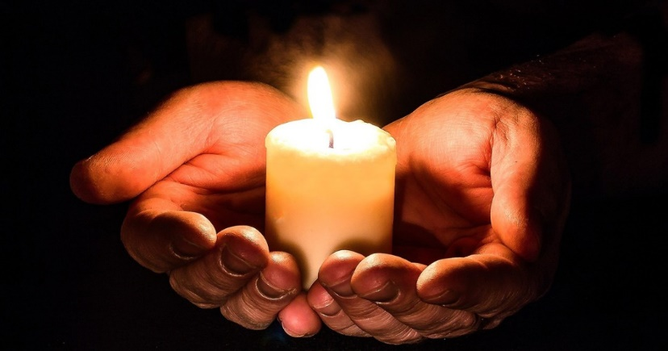
Year 3 Sacramental
and Curriculum Meeting

Slide 2


The Year of Jubilee
Jubilee prayer
God, our loving Father,
In this Jubilee year,
you remind us of our call to love creation.
Help us to work together to replant, repair, and renew.
Guide us on our journey as pilgrims of hope.
Jesus, our light,
In this Jubilee year,
you remind us of our call to love our neighbours and to set free those who suffer.
Help us to treat everyone with dignity; to be fair, forgiving and kind.
Guide us on our journey as pilgrims of hope.
Holy Spirit, our inspiration,
In this Jubilee year, you remind us of our call to grow in faith and love.
Help us to hear you in scripture, to see Jesus in others,
and to be united as God’s global family.
Guide us on our journey as pilgrims of hope.
Notes:
Introduce the Year of Prayer and say together the Our Father

Slide 3
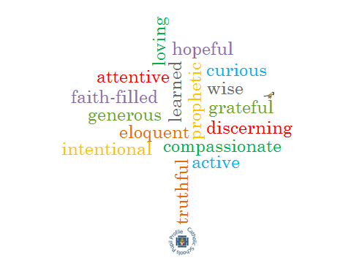
Catholic Social Teaching
Diocesan Mission Statement
Dignity of the human person
Family and Community
Solidarity and The Common Good
Dignity of Work and the Rights of Workers
Rights and Responsibilities
Option for the Poor and Vulnerable
Stewardship of God’s creation
Forming Christ-centred pilgrims of hope with kind hearts, questioning minds, a thirst for knowledge and a hunger for justice.
Virtues
Year 3 Vocational Statement
God called me by my name to
belong to his family.
Notes:
CST is an aspect of the life and thinking of the Catholic Church
It concerns what the church has to say about social issues and the way in which the Catholic faith is lived out within society .
These teachings are rooted in Scripture and especially in the teaching of Jesus in the Gospels

Slide 4
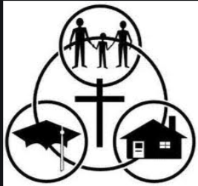
The Sacramental Programme
The Sacraments are an essential element in the life of the Church. Above all, the Sacraments of the Church are an encounter with Christ. The Sacraments give us the opportunity to allow the life of Christ to take root in us, leaving an indelible mark on our souls and strengthening us for the pilgrim journey.
As with all Catholic education, the Sacramental programme is established through a partnership of home, school and parish in order to fully prepare and support the children in their sacramental journey.

Slide 5

The Sacramental Programme
The celebration of sacraments in Year 3 will include :
The Sacrament of Reconciliation
The Sacrament of Holy Communion

Slide 6
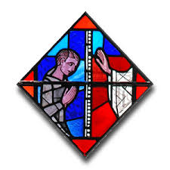
The Sacrament of Reconciliation
In the Sacrament of Reconciliation, the children will experience God’s everlasting love and forgiveness.
They will understand that when we have done something wrong, we need to say sorry to God and ask for His forgiveness.
Reconciliation helps us to restore our peace and friendship with God and leads us back to following his path.

Slide 7
The Sacramental of Reconciliation
To support children in preparing for this sacrament, we want them to understand :
*The difference between right and wrong choices
*That accidents and mistakes are not sins.
*Sins are when we deliberately turn away from God.
*God is loving and merciful and will always forgive us if we ask.
*We must forgive others as God forgives us.
*Jesus granted us the Sacrament of Reconciliation through dying on the cross for us.

Slide 8
Sacramental Preparation in School
Our Learning and Growing RE scheme will help the children to prepare in school.
Unit B Reconciliation –
The children will explore the consequences of the choices we make.
They will understand Jesus’ teachings on forgiveness and how the sacrament of Reconciliation brings us forgiveness from God.

Slide 9
The Sacrament of Reconciliation
There are six key parts of the celebration of the Sacrament.
1)The Examination of Conscience – we think about what we have done wrong.
2)Contrition – we are sorry for what we have done wrong.
3)Confession – we share our sins with the priest.
4)Penance – we accept what we need to do to be forgiven.
5)Absolution – we are forgiven by God through his grace and mercy.
6)Act of penance – we pray or do something as asked by the priest to show we are sorry.

Slide 10
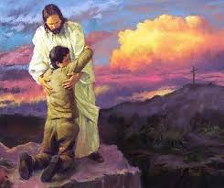
Sacramental Prayers and Stories
The Our Father
The Act of Contrition
The Parable of the Lost Sheep
The Parable of the Prodigal Son
The Parable of the Lost Coin

Slide 11

Sacramental Preparation at Home
Encourage your child to say sorry and ask for forgiveness when they have done something wrong.
Praise and encourage your child when they show forgiveness to others.
Pray the Act of Contrition at home together.
Attend Mass and discuss what is happening.
Talk about God’s love and why God loves your child.
Enjoy sharing Bible stories together.

Slide 12
The Sacrament of the Eucharist
We Listen to God’s Word at Mass -
The children will explore the key parts of the Mass and what our actions and words mean.
The Eucharist is a Thanksgiving to God –
The children will deepen their knowledge and understanding of the Liturgy of the Eucharist. They will think about why this is such an important celebration in the life and worship of Catholics.

Slide 13

Sacramental Stories and Prayers
The Last Supper
Resurrection of Jesus
Prayers of offering the gifts of bread and wine
Eucharistic Prayer
Holy Holy
Lamb of God

Slide 14





Year 3 Curriculum
English – Key Books & Recommended Authors
Notes:
Share with the parents the Curriculum Overview
Pictures of books
Good Authors

Slide 15

Curriculum
English – Key Books
& Recommended Authors
Notes:
Share with the parents the Curriculum Overview
Pictures of books
Good Authors

Slide 16
Curriculum
Maths
Autumn Term
Place Value to 1000
Addition and Subtraction
Multiplication and Division
Spring Term
Multiplication and Division
Length and perimeter
Fractions
Mass and Capacity
Summer Term
Fractions
Money
Time
Shape
Statistics
Notes:
Share key learning in Maths

Slide 17
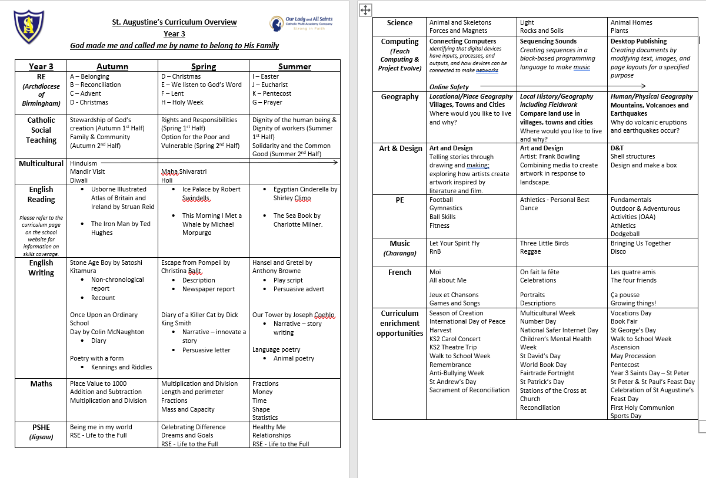
Curriculum
Curriculum Overview
Notes:
Highlight to parents key Learning in the year group across the Curriculum

Slide 18

Key Dates/Activities
Autumn Term
Enrolment Mass – Sunday 19th October at 9am at St. Augustine’s Church (shirt and tie)
Reconciliation & Year of Jubilee Workshop – Friday 21st November 9.15am
Sacrament of Reconciliation – Thursday 4th December 5:30pm
Spring Term
World Book Day – Thursday 5th March
Whole School Retreat Day during Lent (OneLife Music)
Summer Term
First Holy Communion Workshop – Friday 1st May 9:15am
Retreat Day – Alton Castle – Tuesday 5th May
First Holy Communion – Saturday 16th May 9.30am
Going Forth Mass & Corpus Christi Procession – Sunday 7th June 11am
Saints Day – St Peter Monday 29th June (non-uniform)
Trip to Birmingham TBC
Sports Day – Tudor Grange Athletics Track
Notes:
Share Key Dates / Activities for the your Year group

Slide 19
Fr Dominic

Slide 20

MAC Prayer
Lord Jesus,
We pray that your guiding light will forever shine upon our family of Our Lady and All Saints.
Help us to live by your word to love, learn and grow in
faith and friendship together.
May we strive to always follow your example as
we serve as earthly saints
and journey together joyfully in your footsteps.
May we always hear God speaking to our hearts
As we care, share and love one another.
We are all created by God’s love
and faith is our shared foundation.
Our Lady and All Saints
Pray for us.
AMEN

