Slide 1
The National Nurturing Schools Programme
Zones of Regulation

Slide 2




What is the National Nurturing Schools Programme?
  The training programme is 18 months long, St Augustine’s are currently 15 months through this. However, the nurture journey won’t stop when the training finishes!
  A programme led by Nurture UK (an evidence based charity dedicated to improving social, emotional and mental health of children and young people).
  The programme allows staff to develop and embed a nurturing culture throughout school to promote healthy outcomes for all by focusing on emotional needs and development as well as academic learning.
  The programme has been funded by Solihull LA and is being undertaken by the majority of primary schools in Solihull.
Why now?
  We have chosen to participate in the National Nurturing Schools Programme because there has been a significant increase in children struggling with their emotional wellbeing over recent years (both Nationally and at a school level).

Slide 3
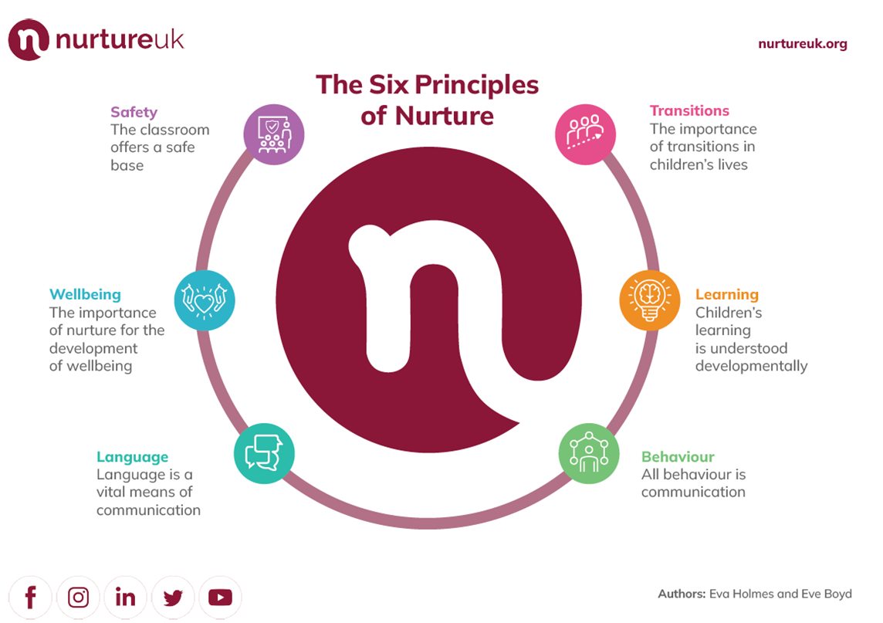
The 6 Nurture Principles
Nurture Principles in Child Speak
  Our school is a safe place to be
  We know how to take care of our body, mind and emotions
  We use our words to show how we feel
  Our behaviour can show how we are feeling
  We all learn in our own way and in our own time.
  We can cope with changes in our lives

Slide 4




What does Nurture look like in school?
Nurture at a Universal and Targeted level- that means for all children, not just those who are struggling.
A few of the things put in place since starting the National Nurturing Schools Programme;
  Addition of extra calming spaces in KS2, in addition to the Woodlands Room
  Increased use of brain/ sensory breaks for everyone
  Introduction of Zones of Regulation to support emotional regulation
  Re-written Behaviour policy to adopt a restorative approach. Children talk through their behaviour and aim to make amends.
  Working in partnership with the Mental Health Support Team
  Providing extra support for parents e.g
Early Help sign posting and mental
health support on the school website

Slide 5
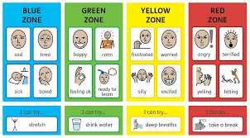
As part of our Nurture work, we have introduced the Zones of Regulation to support children to recognise and regulate their emotions.

Slide 6
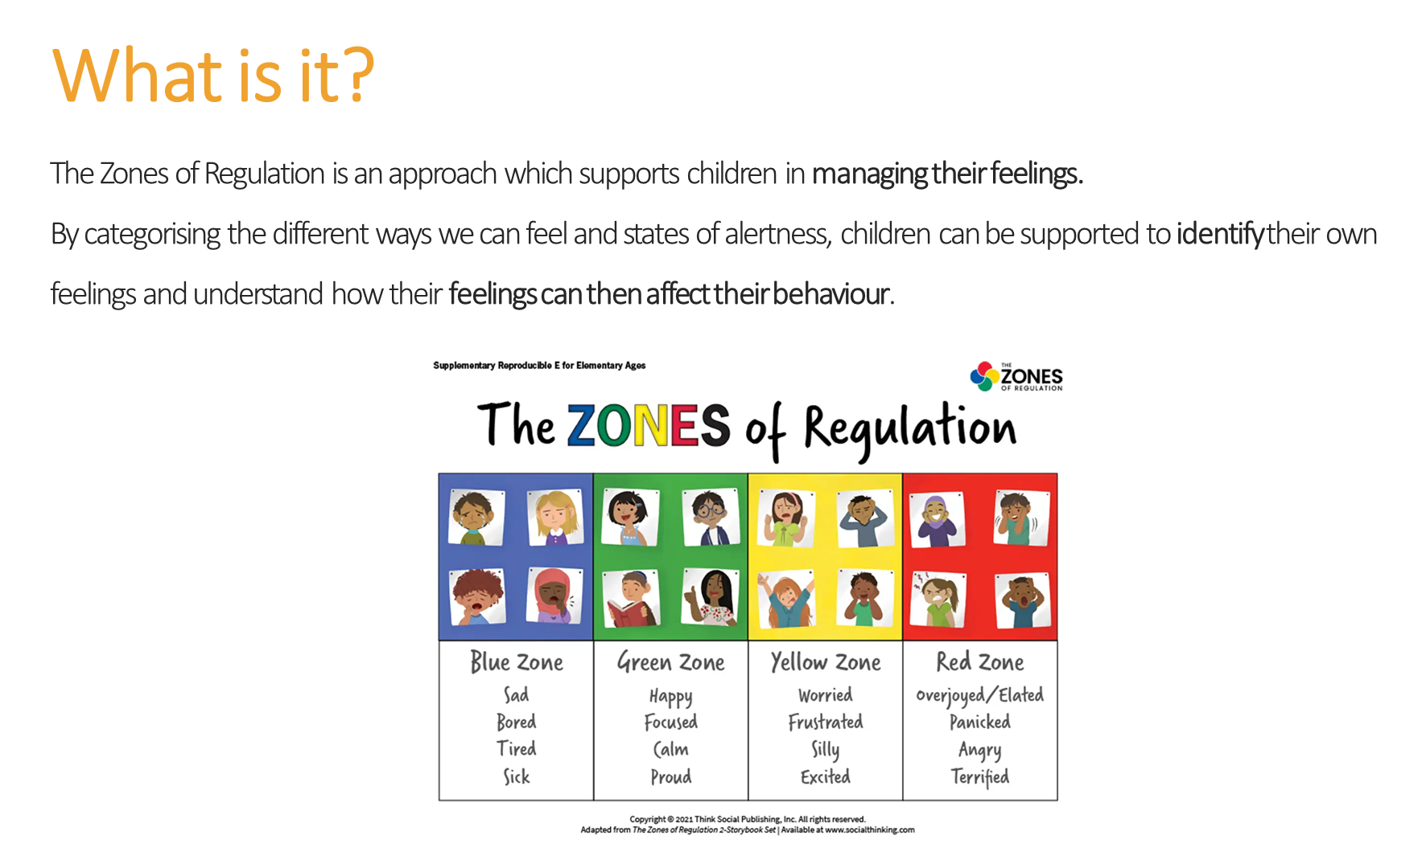

Slide 7
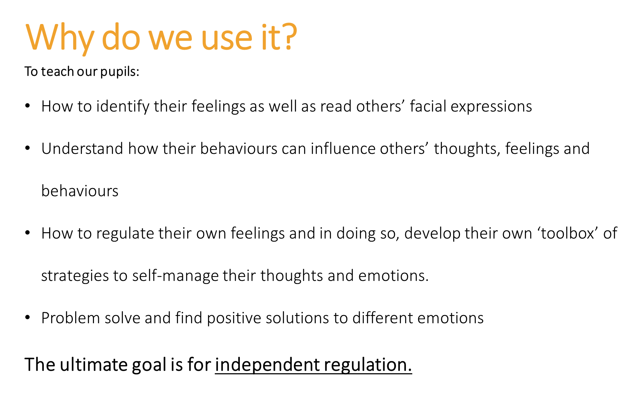


Slide 8
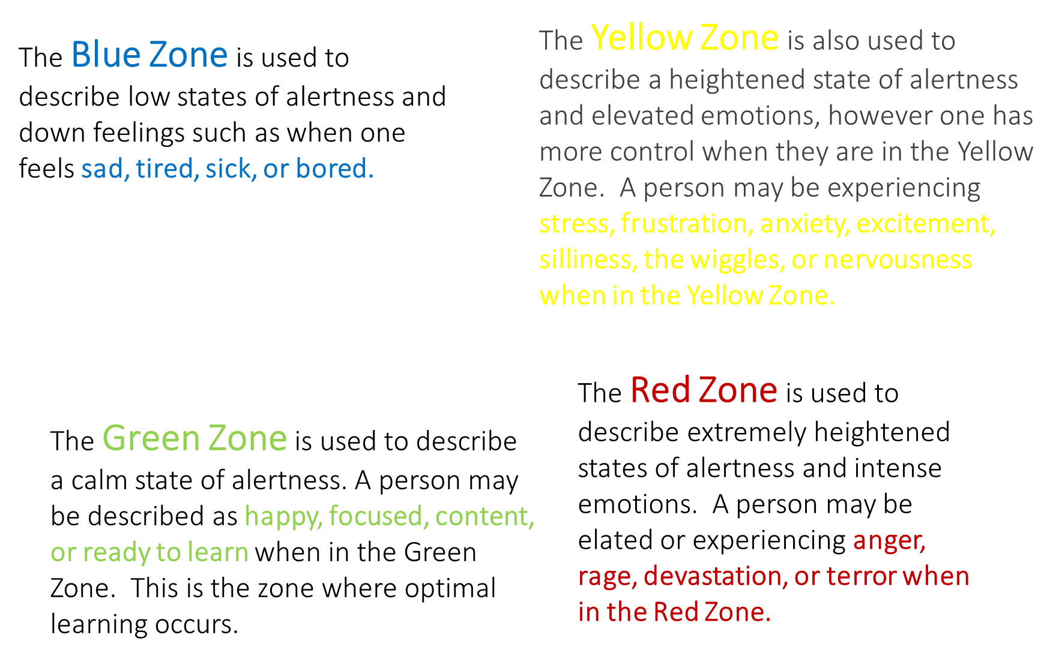


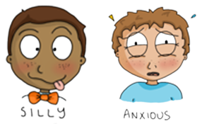

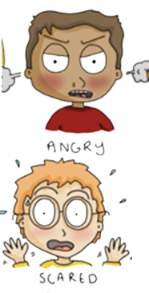

Slide 9
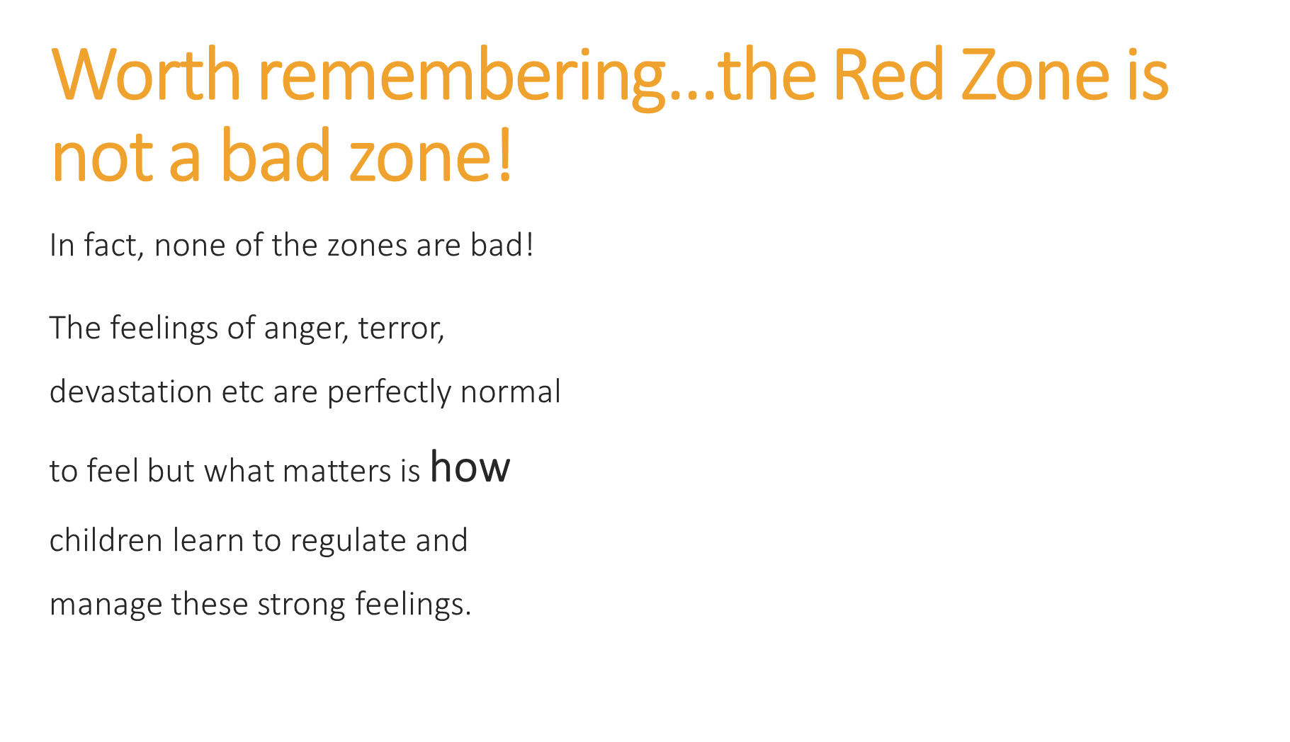
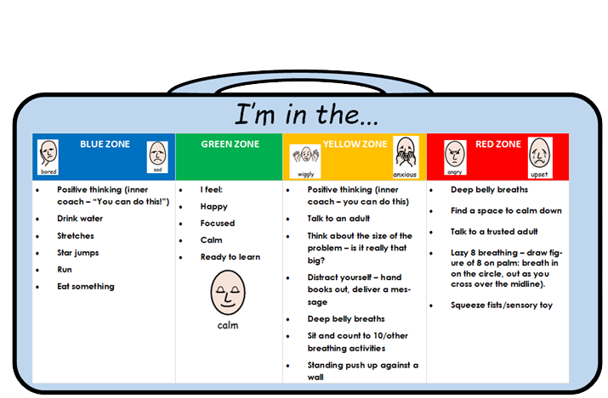

Slide 10
What does it look like in school and how do we use it?
Years 1-6 have been learning the Zones of Regulation Curriculum since September during weekly PSHE lessons. This curriculum covers
What is regulation?
What the 4 Zones are
Recognising body signals
Completing a Zones check in
Situations that may trigger or spark them
Regulation tools and building a Zones toolkit
Nursery and Reception are going to be starting learning about the Zones next week.
What is regulation
Lessons on each of the 4 Zones
Lessons on what to do when they feel in each of the Zones
Building a toolkit.
Outside of PSHE lessons, children are encouraged to complete check-ins throughout the day. Staff will remind them of the tools they can use to regulate.

Slide 11

  On a daily basis, when your child is regulated;
  Display the Zones poster at home and/or make a Zones Check in area. Watch the video here for some examples of how to do this.
  Ask your child ‘How are you feeling? What Zone are you in?’ ‘Shall we do a Zones check in together?’
  Model your own regulation out loud e.g I’m in the Blue Zone this morning, I’m feeling tired, I’m going to do X to help
  Build a toolkit of regulation strategies you can your child can use to help when you feel in a particular zone.
  Talk about which zone characters in a story may be in to support understanding.
  Praise children for trying to use the Zones strategies

Slide 12
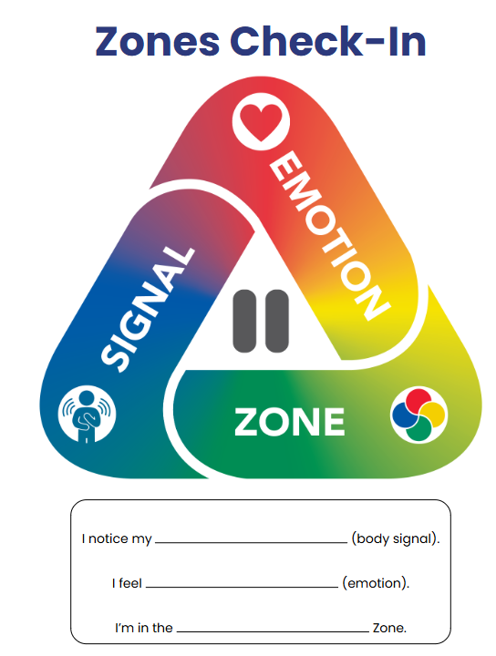
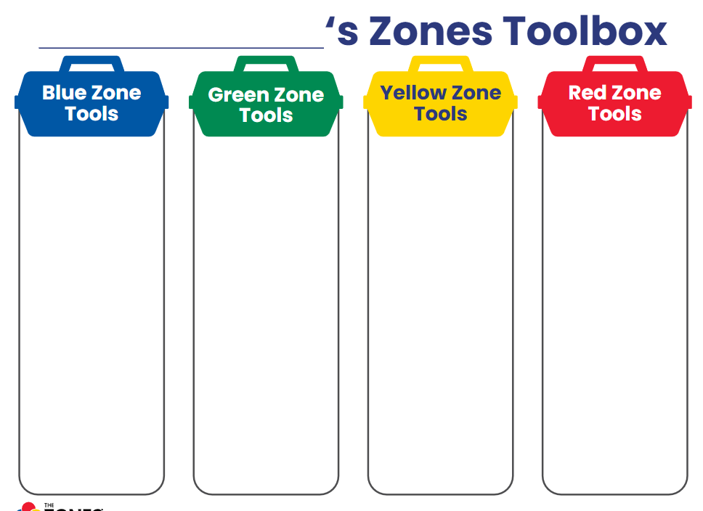
Every child’s tools will be different, will depend on what they’re struggling with and may change depending on the situation.

Slide 13
If your child starts to become dysregulated;
  Make sure you are regulated yourself before supporting your child to regulate
  Encourage your child to complete a Zones check in to identify how they’re feeling, however, they may not be able to do this if they’re already dysregulated.
  Label how you think they are feeling if they are unable to identify themselves e.g ‘I think you may be in the Yellow Zone because I can see you are frustrated. Validate their feelings- ‘I understand you’re feeling frustrated, it’s ok to feel like that, I’d feel frustrated too if someone took my toy’
  What could we do to help you regulate together?’ Use the regulation toolkit as a visual reminder of strategies
  After your child is calm (may be some time later)- separate emotions with behaviour e.g ‘I understand were in the red Zone because were angry, but it’s not ok to hit, what can we do instead? How can we put things right?’

Slide 14
  This is not an overnight fix- it takes time and practice.
  Life is busy! A little every day or every few days is better than nothing.
  Have a look at the resources on the St Augustine’s website- a Zones of Regulation page will be coming soon!
  https://www.st-augustines.solihull.sch.uk/page/?title=Mental+Health+and+Wellbeing&pid=27
  https://www.youtube.com/watch?v=6Lt067sxt3c Recap on The Zone of Regulation
  https://www.theottoolbox.com/zones-of-regulation-activities/
  https://parentswithconfidence.com/calm-down-strategies-for-kids/
  Foy younger children https://www.bbc.co.uk/tiny-happy-people/behaviour-and-wellbeing
  Please let us know if you need more support- we are here to help
  Any questions?

